Slide 1
The Land and Water Conservation Fund What is Happening, Why It Matters, and What Land Trusts Can Do To Help
Presented By:
Graham Chisholm, Conservation Strategy Group
On Behalf of:

Slide 2
LWCF and Land Conservation Goals
LWCF Act: Enacted in 1964 to help preserve, develop and ensure access to natural and recreation resources for future generations.

Slide 3
LWCF and Land Conservation Goals
Create permanent access for recreation
Protect watersheds & drinking water supplies
Protect Wildlife Habitat
Protect important cultural and historic sites
Promote public health
Consolidate lands/create management efficiencies
Support jobs and local economies

Slide 4
LWCF and Land Conservation Key Programs
Federal acquisition of land, water and interests
State and Local Assistance Program - matching grants for state & local parks
Land acquisition, park creation and redevelopment, planning
Other matching grant programs:
USDA Forest Legacy Program – important and threatened forests
USFWS Coop. Endangered Species Program (Sec. 6) – T& E species

Slide 5
LWCF Funding Allocations and Process
Annual Appropriations Process
Funds are allocated to individual bureaus for federal land acquisition (fee or conservation easement)
Project priority lists are sent to Congress as part of annual appropriations process
State and Local Assistance Program & grants through State Parks
Cooperative Endangered Species Act (Section 6)
Other Programs

Slide 6
Average Funding Distribution within LWCF

Slide 7
California & LWCF $2.3 billion
Federal land acquisition -- $1.8 billion
State grants -- $288 million
Sec. 6 grants -- $239 million
Forest Legacy – $16 million

Slide 8
Current Year Appropriations & California
Appropriations in FY17 -- $400 million
Appropriations in FY18 – Still up for grabs (House $272m & Senate TBD) – Coalition target $561 m
Great projects – Save the Redwoods, Mojave Desert Land Trust, Pacific Crest Trail Association, TPL
Appropriations in FY19 – Trump Administration 98% cut from $400 m level

Slide 9
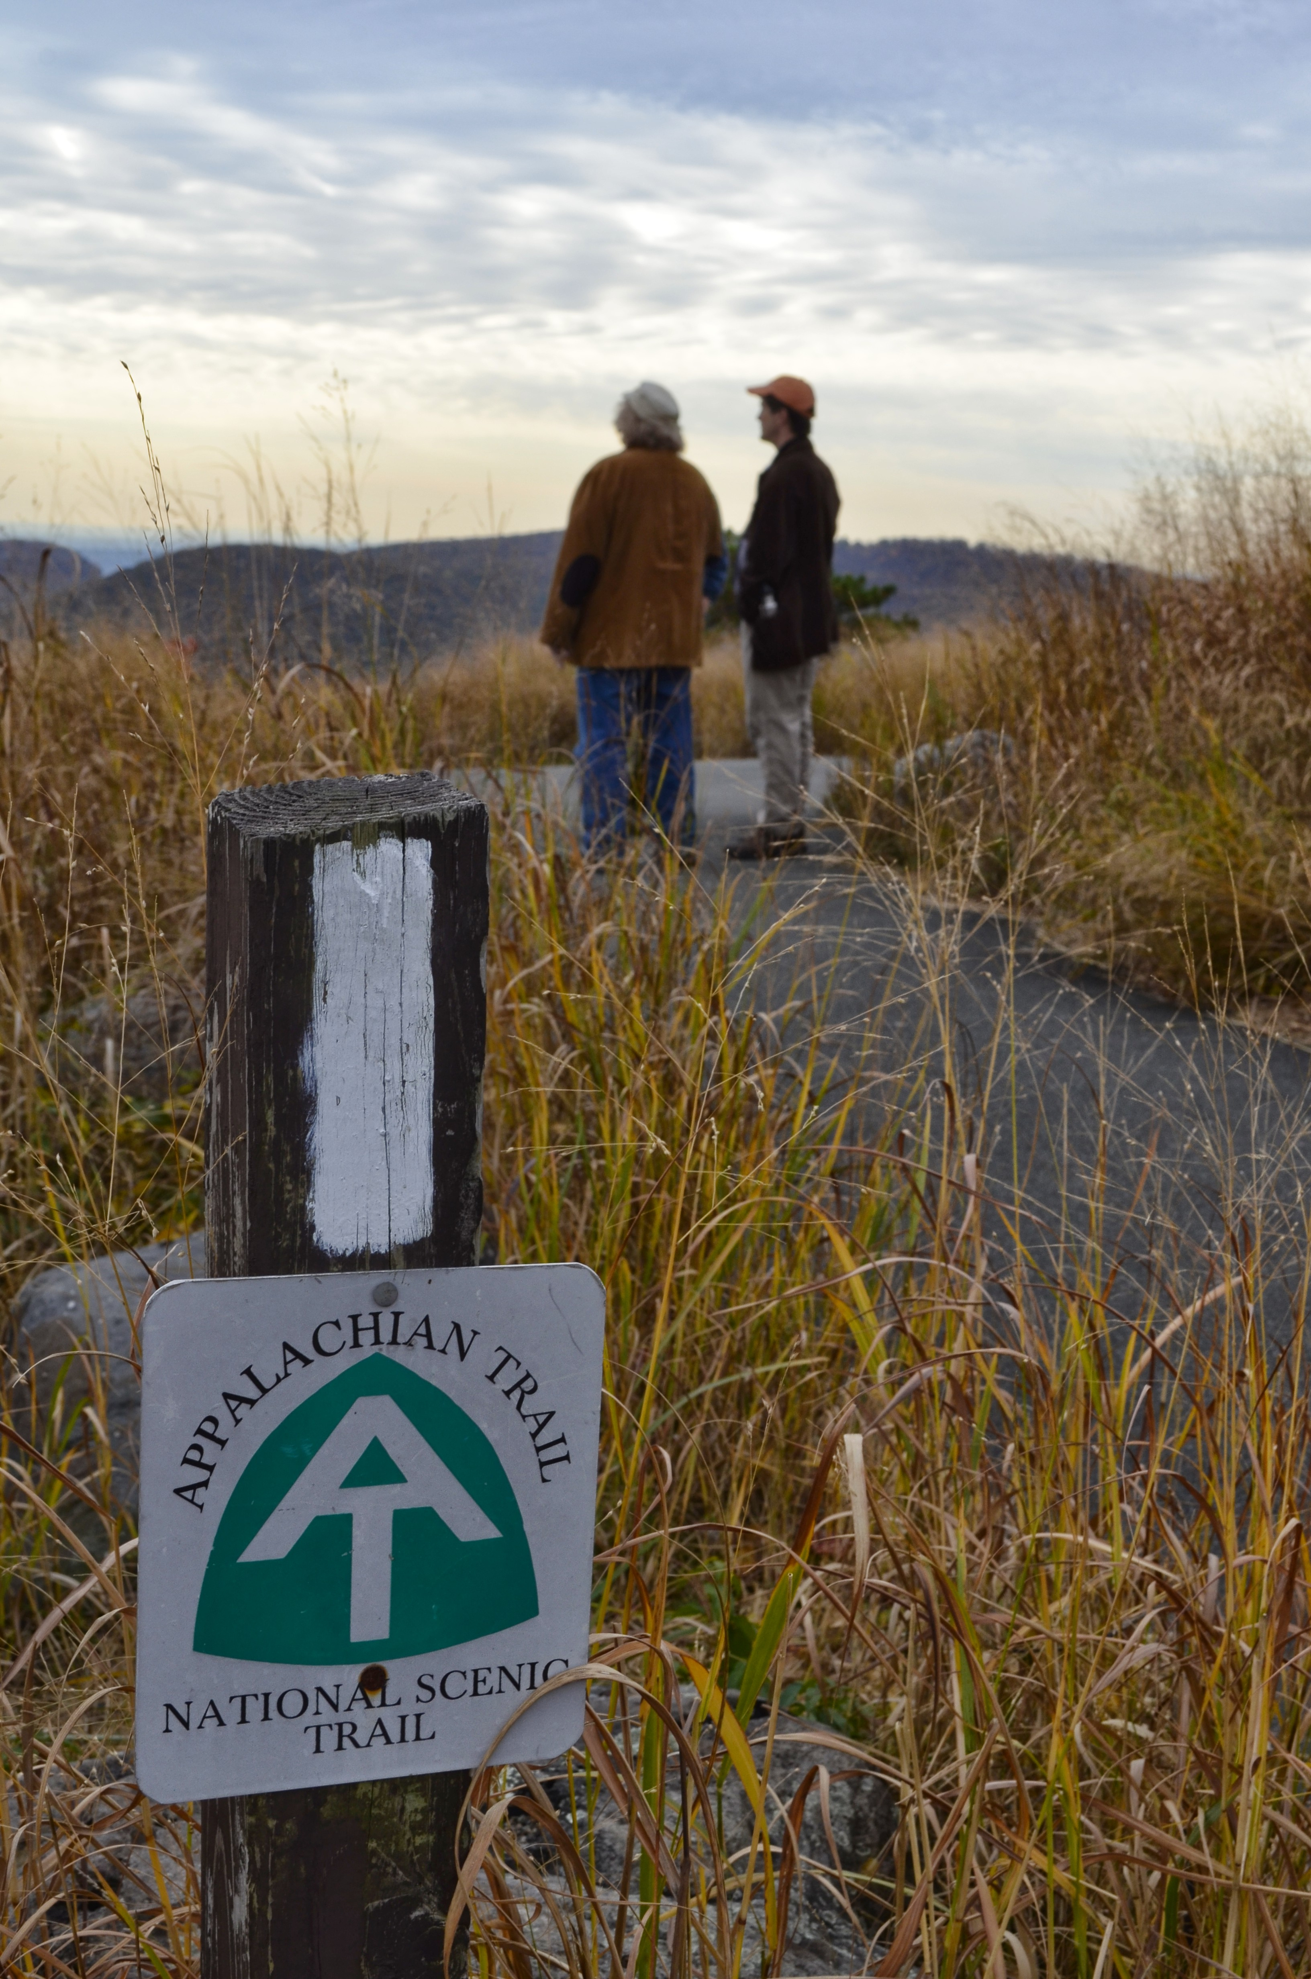
A 52-Year Success Story Could End in 52 29 Weeks
LWCF works
Broad Bipartisan Support
One of the few programs both parties can agree on
Previous reauthorizations were not controversial
Not taxpayer dollars
So What’s the Problem?

Slide 10
Congress is a Tough Place
Political dysfunction seems worse than ever, but
current dynamics have been building for years
Breakdown in regular order
Large legislative packages and “crisis point” deadlines required for anything to move
It is easier than ever for a well-placed, determined opponent to block progress

Slide 11
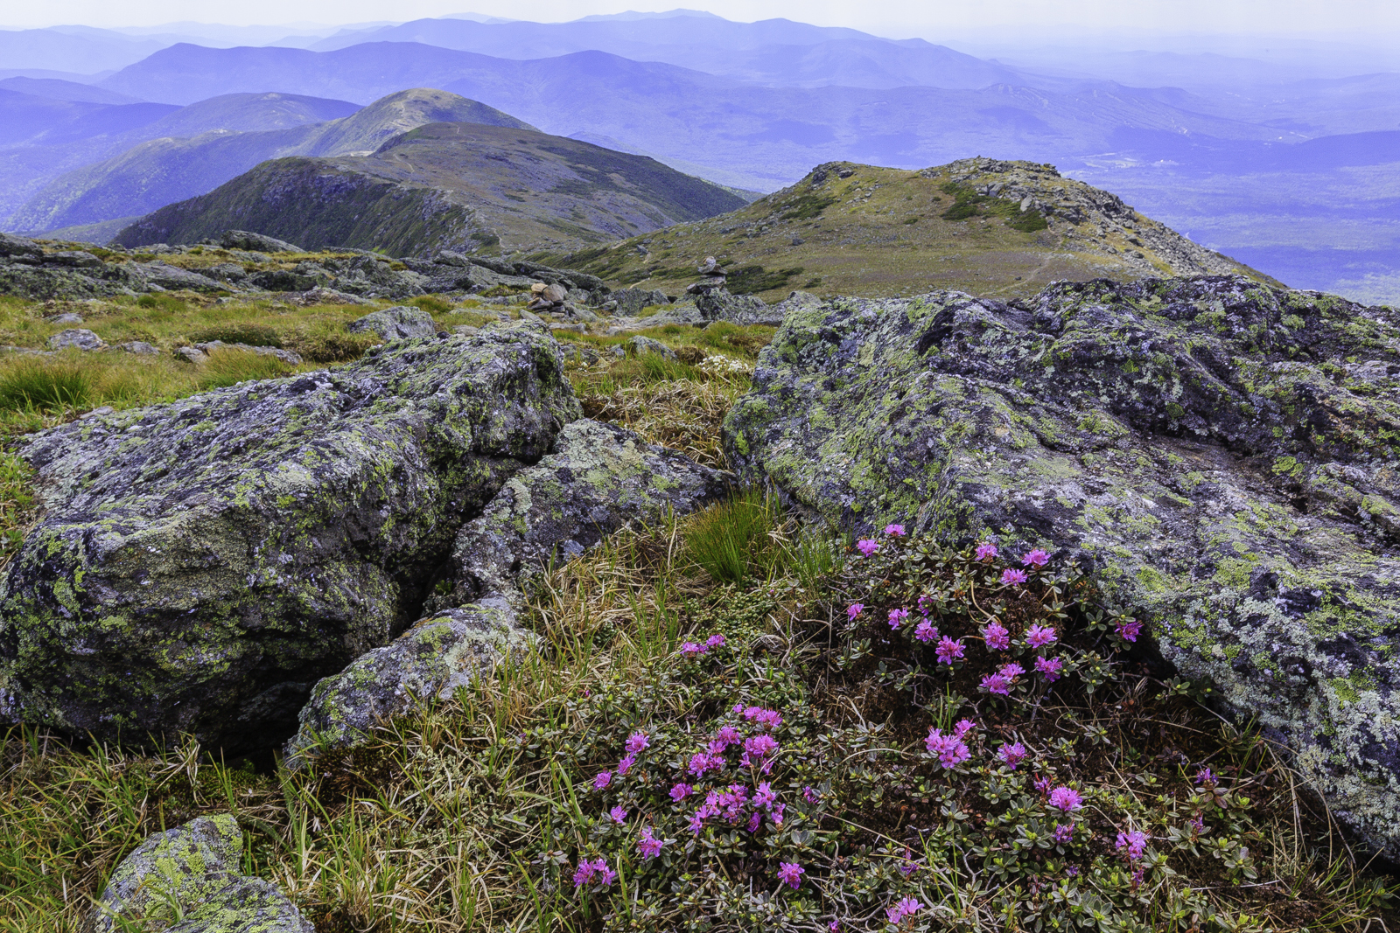
A Strong Coalition is Critical to Success
We have seen that a combination of smart DC strategy and engaged, diverse local stakeholders can overcome these obstacles
Building a strong & diverse coalition
Demonstrating benefits in virtually every county

Slide 12
What is the LWCF Coalition?
Many diverse voices, one unified message: this program works
Large national organizations
Recreation user groups
Outdoor businesses
Sportsmen
Historic preservationists
Community stakeholders
Ranchers, timber companies
Veterans, educators
Minority organizations
Land trusts– large and small, national, regional and local

Slide 13
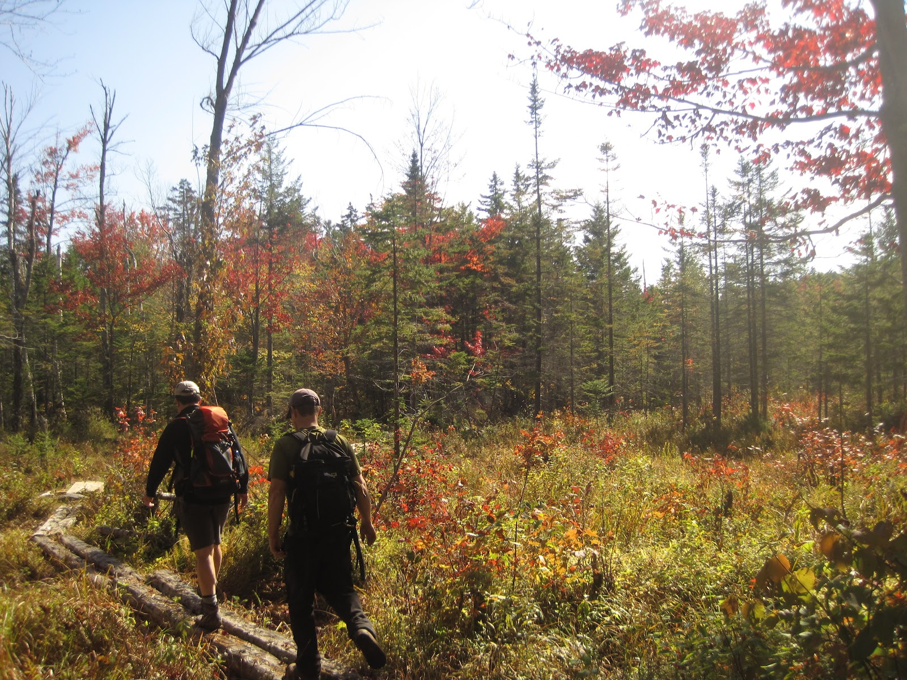
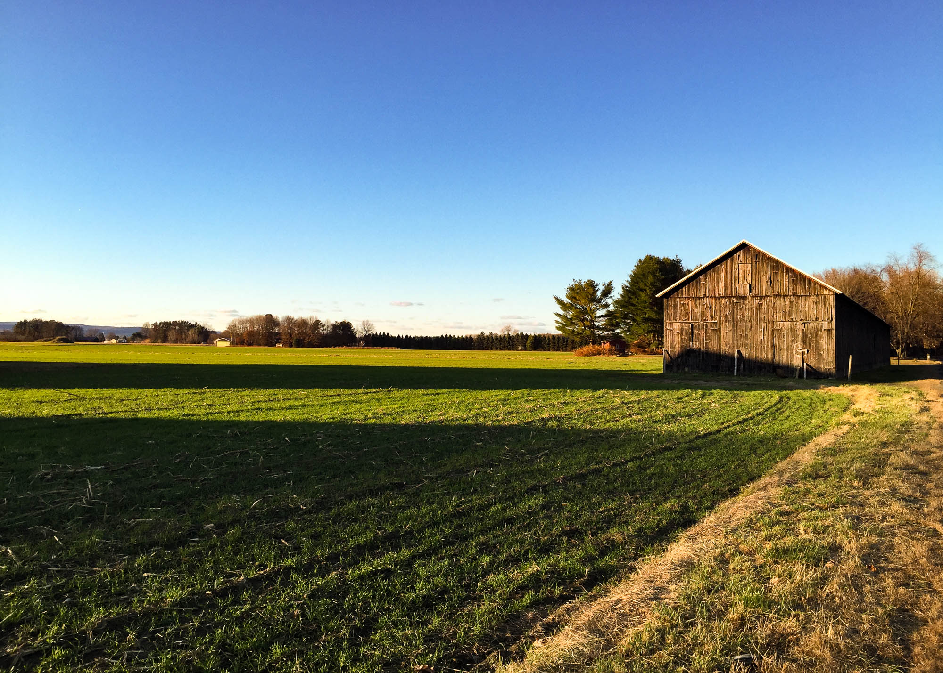
Your Projects Fuel the Coalition’s Advocacy

Slide 14
Key Messages
Non-taxpayer dollars
Asset for an Asset
Flexibility “Tools in the toolbox” to meet communities needs
Economic impact America’s $646 billion outdoor recreation industry supports 6.1 million direct jobs.
Urgency LWCF expires in 7 months
Local Benefits!!

Slide 15
Ways to Get Involved
Connect your Members of Congress with your landscapes through:
- Events, tours with your Representatives and Senators
- Media
- In-district meetings and roundtables with members of Congress
- Come to DC
- Educate your members (sign on letters, blog posts, etc)

Slide 16
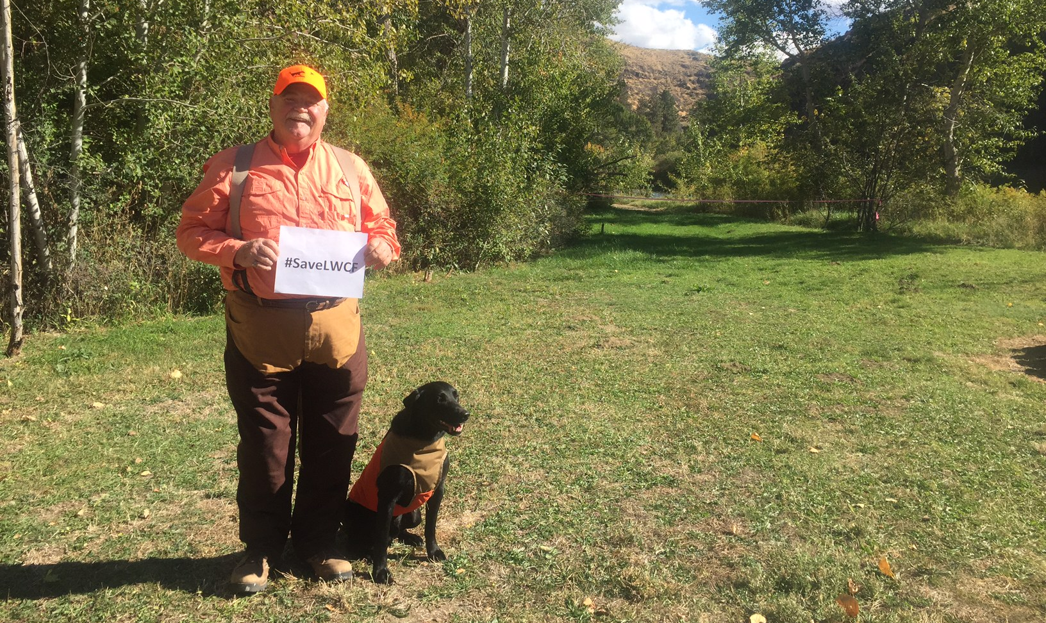

Slide 17
www.lwcfcoalition.com/lwcf52weeks To join the LWCF Coalition or more information email me: graham@csgcalifornia.com
For more information and resources:

